Slide 1
Angular 2 forms directives

Slide 2
Form with validation
<form #heroForm ="ngForm" *ngIf="active" (ngSubmit)="onSubmit()"> <div class="form-group”> <label for="power">Hero Power</label> <select #power ="ngModel" class="form-control” name="power" [(ngModel)]="hero.power" required > <option *ngFor="let p of powers" [value]="p">{{p}}</option> </select> <div *ngIf="power.errors && power.touched" class="alert alert-danger"> <div [hidden]="!power.errors.required">Power is required</div> </div> </div> <button type="submit" class="btn btn-default" [disabled]="!heroForm.form.valid">Submit</button> </form>
@Component({selector: 'hero-form', templateUrl: 'hero-form.html'}) export class HeroFormComponent { powers = ['Really Smart', 'Super Flexible', 'Weather Changer']; hero = new Hero(18, 'Dr. WhatIsHisWayTooLongName', this.powers[0], 'Dr. What'); onSubmit() {
this.heroService.saveHero(this.hero).subscribe(res=>
router.navigateByUrl("/"))
} }

Slide 3
Validation: built in validators
required - Requires a form control to have a non-empty value
minlength - Requires a form control to have a value of a minimum length
maxlength - Requires a form control to have a value of a maximum length
pattern - Requires a form control’s value to match a given regex
<form novalidate> <input type="text" name="name" ngModel required> <input type="text" name="street" ngModel minlength="3"> <input type="text" name="city" ngModel maxlength="10"> <input type="text" name="zip" ngModel pattern="[A-Za-z]{5}"> </form>

Slide 4
Form validation results
State | Class if true | Class if false
Control has been visited | ng-touched | ng-untouched
Control's value has changed | ng-dirty | ng-pristine
Control's value is valid | ng-valid | ng-invalid
.ng-valid[required] { border-left: 5px solid #42A948; /* green */ } .ng-invalid.ng-touched { border-left: 5px solid #a94442; /* red */ }

Slide 5
Show validation messages
<input type="text" class="form-control" required
[(ngModel)]="model.name"
name="name" #name>
<div [hidden]="name.valid" class="alert alert-danger">
Name is required
</div>

Slide 6
Input field and validation messages
<input type="text" id="name" class="form-control" required minlength="4" maxlength="24“ name="name" [(ngModel)]="hero.name" #name="ngModel" > <div *ngIf="name.errors && (name.dirty || name.touched)" class="alert alert-danger"> <div [hidden]="!name.errors.required"> Name is required </div> <div [hidden]="!name.errors.minlength"> Name must be at least 4 characters long. </div> <div [hidden]="!name.errors.maxlength"> Name cannot be more than 24 characters long. </div> </div>

Slide 7
Drawbacks of validation messages in the code
It takes a lot of HTML to represent all possible error conditions. This gets out of hand when there are many controls and many validation rules.
We're not fond of so much JavaScript logic in HTML.
The messages are static strings, hard-coded into the template. We often require dynamic messages that we should shape in code.
We can move the logic and the messages into the component with a few changes to the template and component.

Slide 8
validation results in component code
<form #heroForm="ngForm" *ngIf="active" (ngSubmit)="onSubmit()"> <input type="text" id="name" class="form-control" required minlength="4" maxlength="24" forbiddenName="bob" name="name" [(ngModel)]="hero.name" > <div *ngIf="formErrors.name" class="alert alert-danger"> {{ formErrors.name }} </div> </form>
@ViewChild('heroForm') heroForm: NgForm; ngOnInit() { this.heroForm.valueChanges .subscribe(data => this.onValueChanged(data)); }

Slide 9
Fill validation messages from code
onValueChanged(data?: any) { if (!this.heroForm) { return; } const form = this.heroForm.form; for (const field in this.formErrors) { // clear previous error message (if any) this.formErrors[field] = ''; const control = form.get(field); if (control && control.dirty && !control.valid) { const messages = this.validationMessages[field]; for (const key in control.errors) { this.formErrors[field] += messages[key] + ' '; } } } }
validationMessages = { 'name': { 'required': 'Name is required.', 'minlength': `Name must be
at least 4 characters long.`, 'maxlength': `Name cannot be
more than 24 characters long.` }, 'power': { 'required': 'Power is required.' } };
formErrors = { 'name': '', 'power': '' };
<div *ngIf="formErrors.name" > {{ formErrors.name }} </div>

Slide 10
Reactive form
<form novalidate [formGroup]="form"> <input type="text" name="name" ngModel > <input type="text" name="street" ngModel > <input type="text" name="city" ngModel > <input type="text" name="zip" ngModel > </form>
@Component() class Cmp { constructor(private fb: FormBuilder) {} ngOnInit() { this.form = this.fb.group({ name: ['', Validators.required], street: ['', Validators.minLength(3)], city: ['', Validators.maxLength(10)], zip: ['', Validators.pattern('[A-Za-z]{5}')] }); }}
Reactive form benefits: you can
add, change, and remove validation functions on the fly
manipulate the control model dynamically from within the component
test validation and control logic with isolated unit tests.

Slide 11
Import reactive forms module
@NgModule({ imports: [ SharedModule, ReactiveFormsModule ], declarations: [ HeroFormReactiveComponent ], exports: [ HeroFormReactiveComponent ] }) export class HeroFormReactiveModule { }

Slide 12
Custom validation function
export function forbiddenNameValidator(nameRe: RegExp): ValidatorFn { return (control: AbstractControl): {[key: string]: any} => { const name = control.value; const no = nameRe.test(name); return no ? {'forbiddenName': {name}} : null; }; }
Use in reactive form:
'name': [this.hero.name, [
Validators.required,
Validators.minLength(4),
Validators.maxLength(24),
forbiddenNameValidator(/bob/i)
]
],

Slide 13
Custom validator directive
@Directive({ selector: '[startWith]', providers: [{provide: NG_VALIDATORS, useExisting: CustomValidatorDirective,
multi: true}] }) export class CustomValidatorDirective implements Validator{ @Input('startWith') expr: string;
validate(control: AbstractControl) { if(control.value && !control.value.startsWith(this.expr)){ return {'startWith': control.value}; } return null; } }
<input [startWith]="a" ngModel name=“name”>

Slide 14
Attribute directive
<p myHighlight>Highlight me red</p>
<p [myHighlight]="color“ [size]=2>Highlight me!</p>
@Directive({ selector: '[myHighlight]' }) export class HighlightDirective { private _defaultColor = 'red'; constructor(private el: ElementRef) { } @Input('myHighlight') highlightColor: string;
@Input('size') size: number;
@HostListener('mouseenter') onMouseEnter() { this.highlight(this.highlightColor || this._defaultColor); } @HostListener('mouseleave') onMouseLeave() { this.highlight(null); } private highlight(color: string) { this.el.nativeElement.style.backgroundColor = color; } }

Slide 15
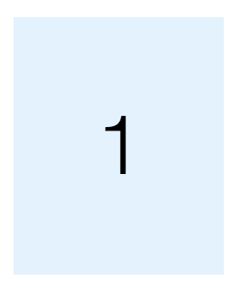
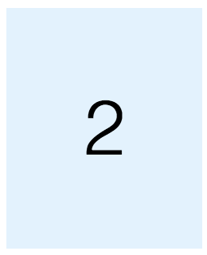
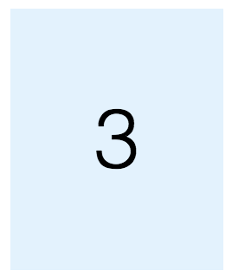
Structural directive
@Component({ selector: 'app', template: ` <div *ngFor="let item of [1,2,3]">
<card *delay="500 * item"> {{item}} </card>
</template> </div> ` }) export class AppComponent { }
@Directive({ selector: '[delay]' }) export class DelayDirective { constructor( private templateRef: TemplateRef<any>, private viewContainerRef: ViewContainerRef ) { } @Input('delay') set delayTime(time: number): void { setTimeout(()=>{ this.viewContainerRef .createEmbeddedView( this.templateRef); }, time); }
@Component({ selector: 'card', template: `
<ng-content></ng-content>`}) export class CardComponent {}

Slide 16
Structural directive
@Component({ selector: 'app', template: ` <div *ngFor="let item of [1,2,3]">
<template [delay]="500 * item"> <card > {{item}} </card>
</template> </div> ` }) export class AppComponent { }
@Directive({ selector: '[delay]' }) export class DelayDirective { constructor( private templateRef: TemplateRef<any>, private viewContainerRef: ViewContainerRef ) { } @Input('delay') set delayTime(time: number): void { setTimeout(()=>{ this.viewContainerRef .createEmbeddedView( this.templateRef); }, time); }
@Component({ selector: 'card', template: `
<ng-content></ng-content>`}) export class CardComponent {}

